Slide 1
CHI

Slide 2
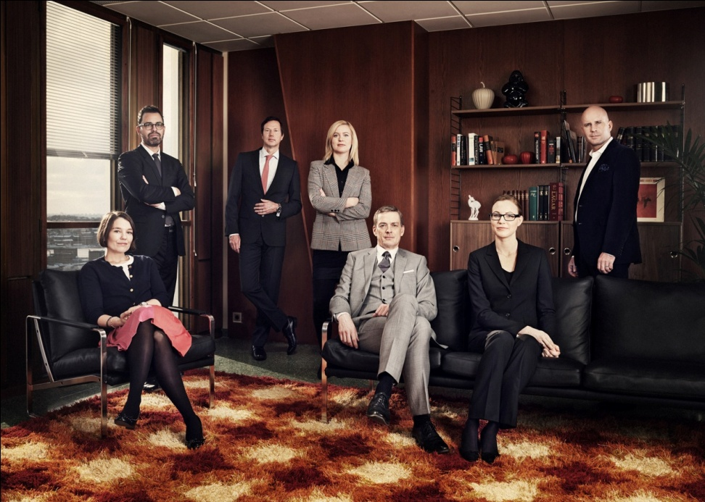
Westermark Anjou
Established 2005
12 partners and 18 Associates
True partnership
Life balance
Full service
Partner attention
Excellence in focus areas
Local and international clients
Solid network of lawyers and experts in non-focus areas
Member of the Cicero Legal Network
Close to the academic society
Extensive training program

Slide 3
Practice areas
Corporate Law
Private M&A
Capital Market
Financing
Real Estate
Dispute resolution
IPR, Media and Marketing
Commercial Agreements
Corporate Sustainability, Risk Management and Compliance
Two partners active in each focus area

Slide 4
Kontaktuppgifter
Advokatfirman Westermark Anjou
Sergels torg 12
Box 16030
103 21 Stockholm
www.westermarkanjou.se
www.ciceroleague.com
Carl-Adam Drakenberg Advokat, partner Företagsöverlåtelser Tel: +46 76 12 69 119 Epost: cad@westermarkanjou.se

